Slide 1

Aerial Object Detection
Pranav Dulepet, Mukund Shankar, Anirudh Poruri, Sathya Gnanakumar
Notes:
Sathya

Slide 2

The Challenge
Prompt: Write a program that ingests a provided image set or video feed and then produces an event stream / log of objects identified.
We chose to detect aerial objects which may pose a threat to national security, such as…
“Balloons”
While many models currently exist to identify objects in images or videos, they are highly inaccurate (as we will demonstrate).
Our goal is to train a model such that it is able to correctly and accurately identify objects (potential airborne threats) using computer vision algorithms.
Notes:
Sathya

Slide 3

Our idea
Unidentifiable aerial objects are a threat to national security.
In light of recent events, we have seen the magnitude of threat these objects pose.
We need to be able to identify these objects as soon as possible to take the appropriate action.
Notes:
Ani

Slide 4
The Opportunity
Needs more training for specific context
Generic CNN-based Object Detection models such as YOLO
Notes:
Ani

Slide 5

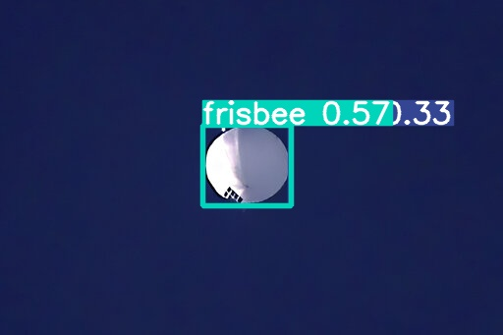
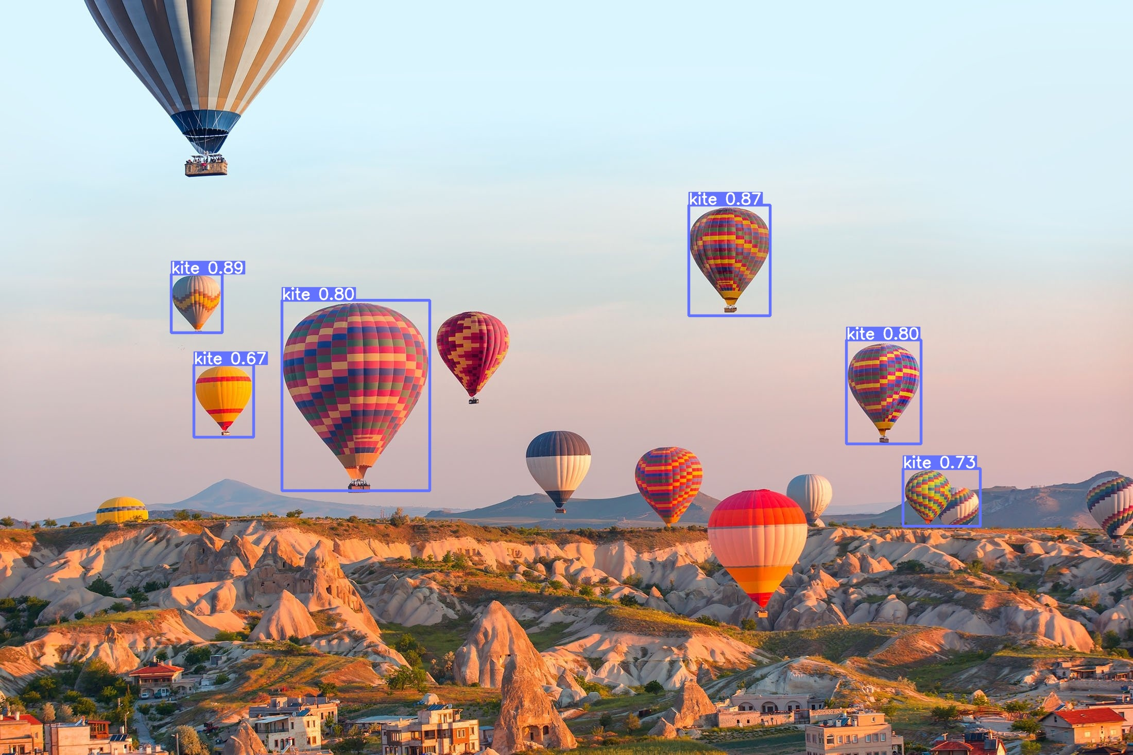
The Opportunity
Figure 1: A balloon as (incorrectly) classified by generic YOLOv5 model
Figure 2: A group of hot air balloons as (incorrectly) classified by generic YOLOv5 model
Notes:
Ani

Slide 6

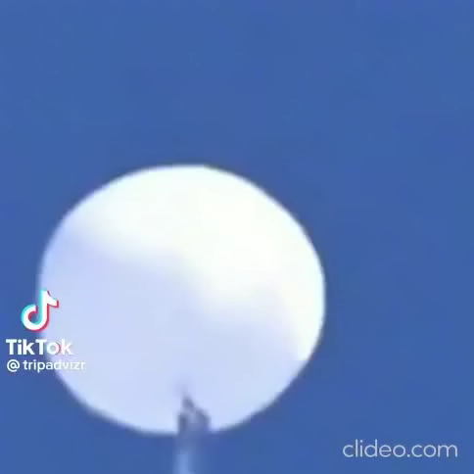
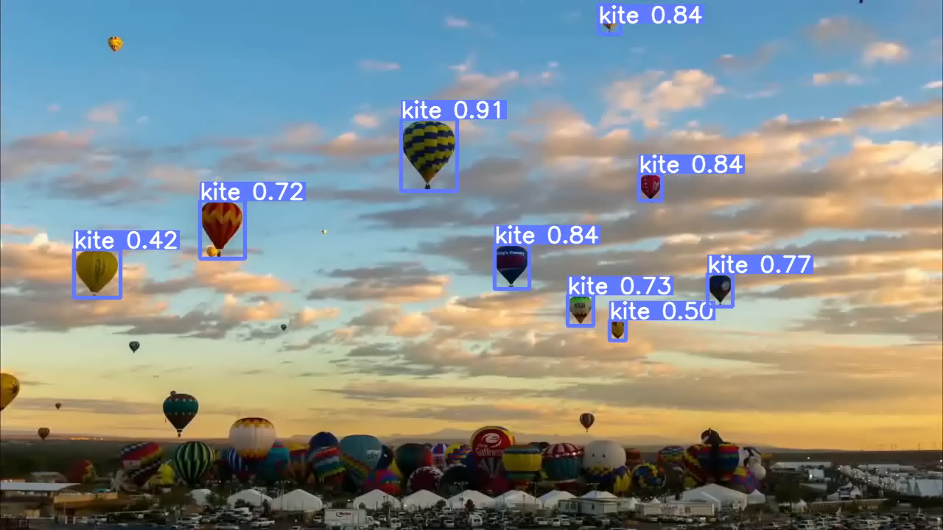
The Opportunity
Figure 3: A video of a balloon as (incorrectly) classified by generic YOLOv5 model
Figure 4: A video of a group of hot air balloons as (incorrectly) classified by generic YOLOv5 model
Notes:
Ani

Slide 7
Our Solution
Generic CNN model
Inferencing
Transfer learning with contextual data
Notes:
Pranav

Slide 8

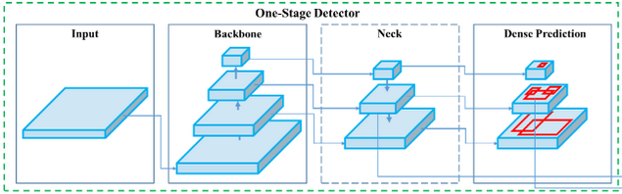
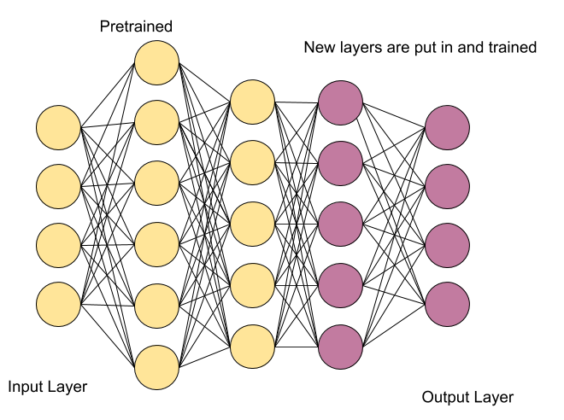
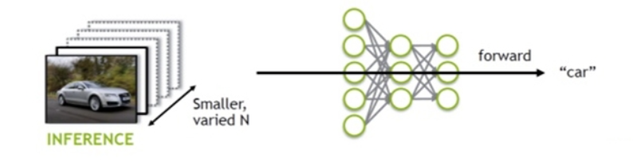
How does it all work?
YOLOv5
Transfer Learning
Figure 5: YOLOv5 architecture
Inferencing
Figure 7: Diagram describing transfer learning
Figure 6: Diagram describing inferencing
Notes:
Pranav

Slide 9
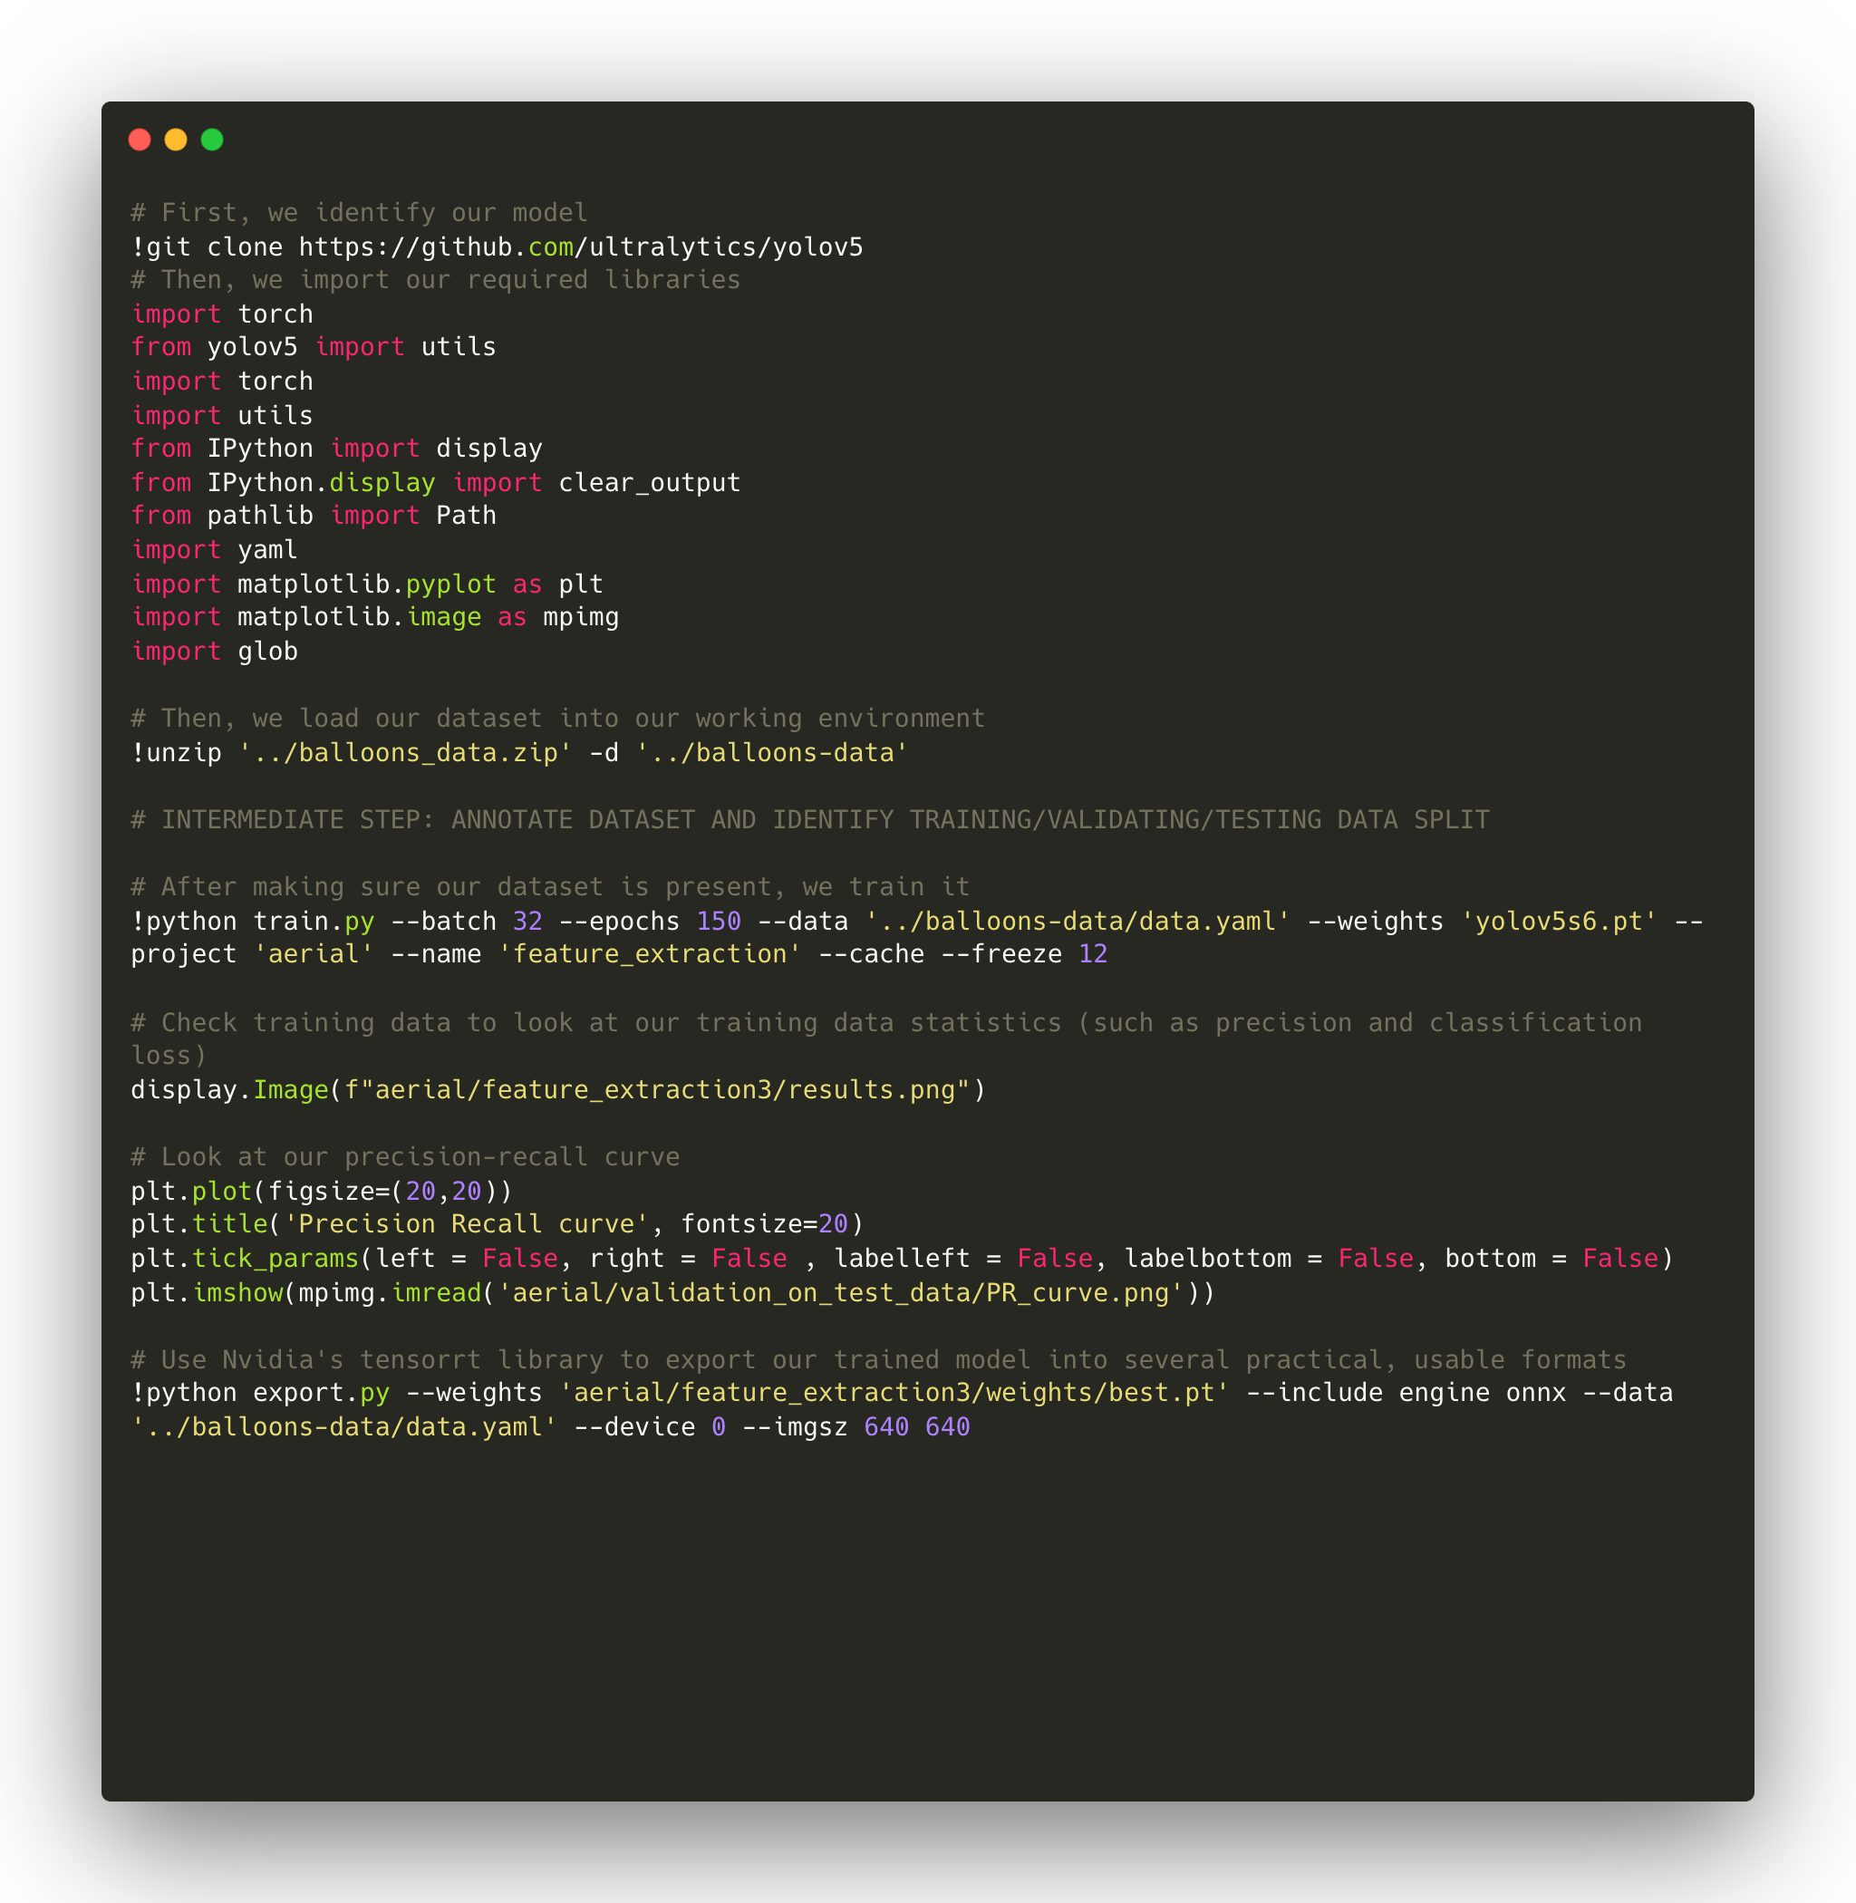

The code
This code snippet is used to acquire required libraries, load our dataset into the working environment, train our data, display metrics used to measure performance of our model, and export our model
Some intermediate steps were skipped from this code snippet (such as defining training/testing/validation data splits) as they were done separately.
Notes:
Mukund

Slide 10
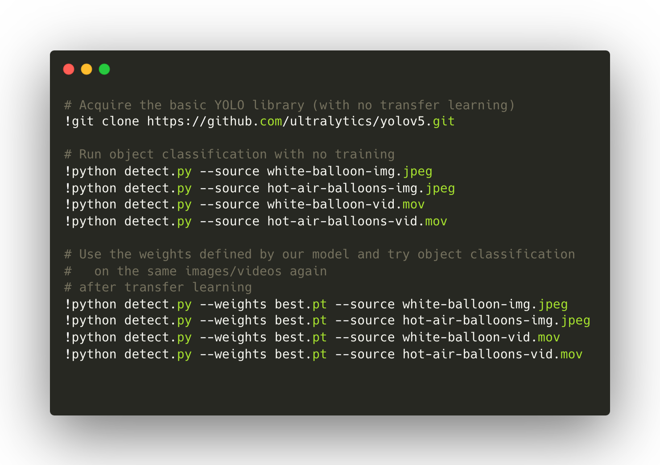
The code
This code snippet is what we used to perform inferencing.
First, we used the generic YOLOv5 model.
Then, we used the weights defined by our trained model (after applying transfer learning). Results coming up.
Notes:
Mukund

Slide 11

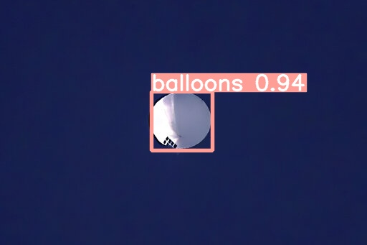
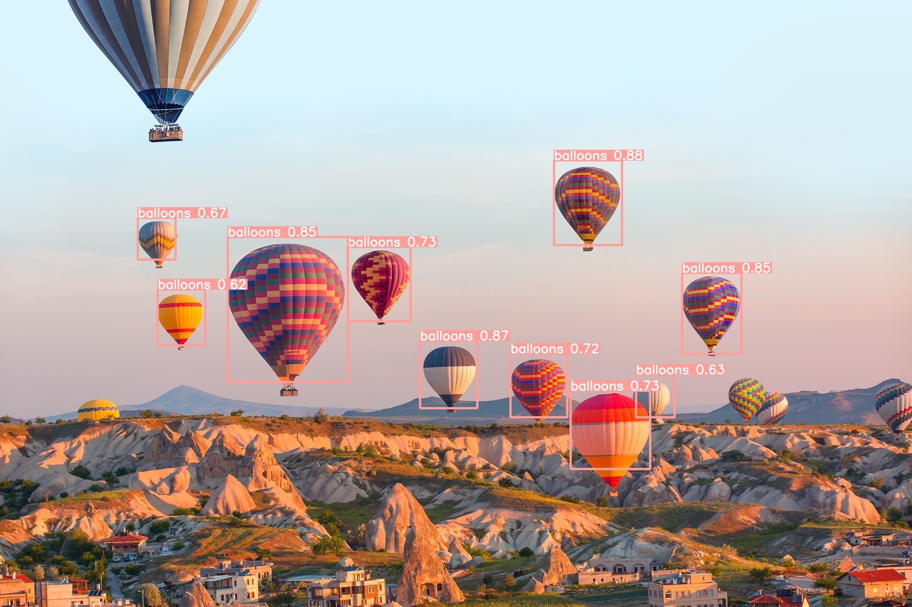
Our model in action
Figure 8: A balloon as classified by our model
Figure 9: A group of hot air balloons as classified by our model
Notes:
Mukund

Slide 12
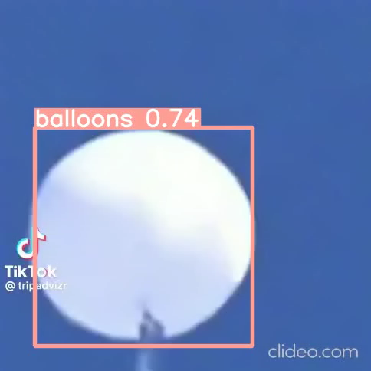
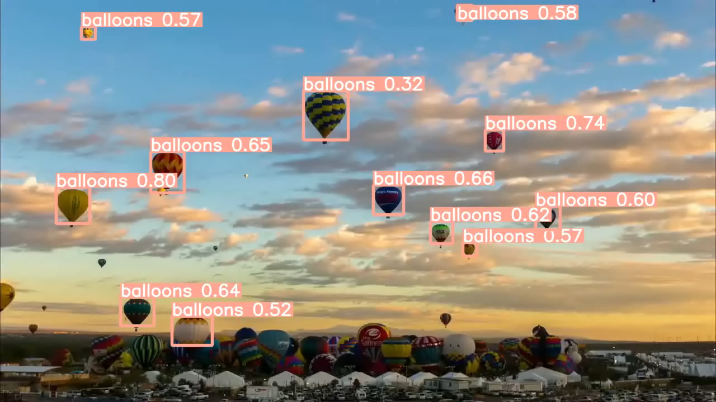
Our model in action
Figure 10: A video of a balloon as classified by our model
Figure 11: A video of a group of hot air balloons as classified by a our model
Notes:
Mukund

Slide 13

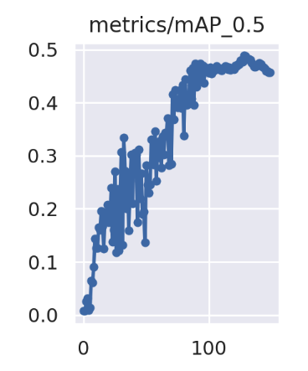
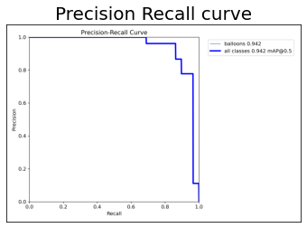
Metrics
Figure 12: Quality and quantity of correctly classified inputs
Figure 13: mAP score by epoch
Notes:
Pranav

Slide 14

Future Improvements
When identifying threats, we need to keep some threat factors in mind:
Flight path
Shape & Size of object
Maneuverability
Time in sky
Time when object is detected
Threats could be larger, carry more equipment, have more maneuverability, and appear at odd times during the day
Another important factor to consider is how falsely flagging allies as hostiles and vice versa can be avoided.
To mitigate these risks, some steps can be taken:
Train on more contextual data
More robust fine-tuning including changing weights, adding custom layers, etc.
Incorporate a feedback loop

Slide 15
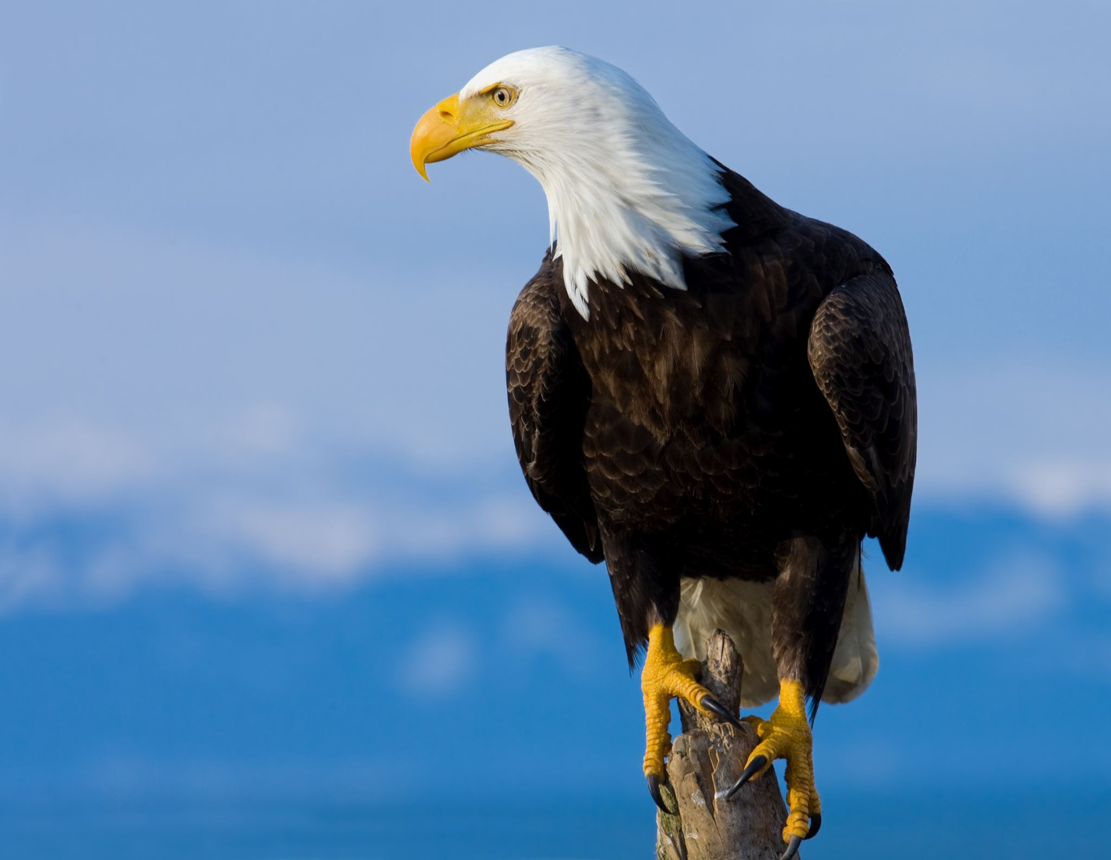

Use cases
Business
Other
Drone Imagery
Ground Troop Protection
Precise Target Engagement
Autonomous piloting systems
Mobile app for civilians to detect objects
Notes:
Sathya

Slide 16
Appendix
High-level conceptual model
References

Slide 17
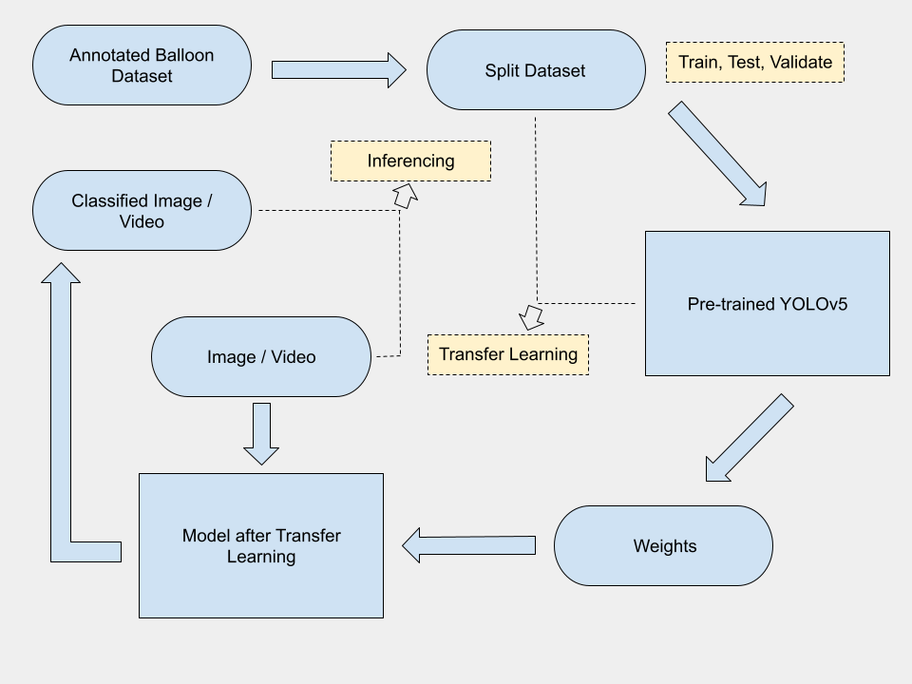
High-level Conceptual Model

Slide 18
References
Figure 1: https://www.nytimes.com/2023/02/04/us/politics/chinese-spy-balloon-obsession.html
Figure 2: https://www.dailysabah.com/life/hot-air-balloon-festival-kicks-off-in-turkeys-famed-cappadocia/news
Figure 3: https://www.tiktok.com/@tripadvizr/video/7196418536355548422?_r=1&_t=8aFwx2sxDf1
Figure 4: https://www.youtube.com/watch?v=QGAMTlI6XxY
Figure 5: https://iq.opengenus.org/yolov5/
Figure 6: https://www.analyticssteps.com/blogs/how-transfer-learning-done-neural-networks-and-convolutional-neural-networks
Figure 7: https://www.exxactcorp.com/blog/HPC/discover-the-difference-between-deep-learning-training-and-inference
Figure 8: https://colab.research.google.com/drive/1E19M4QNhCYRgPpp8NUHwRt0NWobxXGZO?usp=sharing
Figure 9: https://colab.research.google.com/drive/1E19M4QNhCYRgPpp8NUHwRt0NWobxXGZO?usp=sharing
Symbols: https://developer.apple.com/sf-symbols/

